Slide 1
PowerCLI 301
CODE1745LV
Functions upon Functions
Justin Sider
Chief PowerShell Officer – Belay Technologies
# CODE1745LV
Broadcom Proprietary and Confidential. Copyright © 2024 Broadcom.
All Rights Reserved. The term “Broadcom” refers to Broadcom Inc. and/or its subsidiaries.

Slide 2
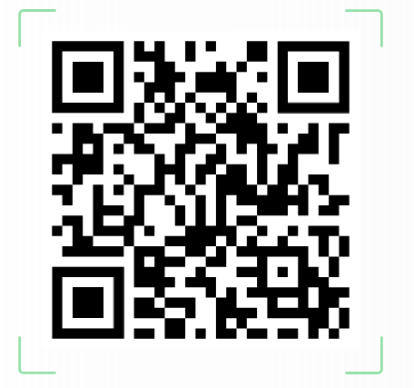
Takeaways
Understand Pseudo Code
Understand how to write Functions
Understand how to create PowerShell Modules
Slides & Code

Slide 3
Agenda
PowerShell Basics (Really quick)
Functions
Cmdlets
Advanced Functions
Modules
PowerShell Gallery
Pseudo Code
Local Modules

Slide 4
PowerShell 101
Sorry – I have to review this!
Verb-Noun
Example – Get-VM
Approved Verbs? -> Get-Verb
Objects
A collection of 3 types of Data that represents an Item.
Object Type
What am I?
Methods
What can you do to me?
Properties
What are the things that describe me?

Slide 5
PowerShell Functions
What are they?
Functions do not need to be verb-noun…. But don’t be that person!
A list of PowerShell statements that has a name you assign.
Wait – That sounds like a PowerShell script!
My Opinion
Functions should do 1 thing well
A Script might call several to many functions to complete a larger task.
Function
Get-VM
Function
Shutdown-VMGuest
Function
Set-VM
Function
Start-VM
Script
Get a list of VM’s
Safely shut them down
Edit the Number of CPU’s
Power the VM’s back on

Slide 6


PowerShell Cmdlets
I hear this all the time… What is it?
A Cmdlet is a .NET class written in C# or another .NET Language and contained in a .dll (Binary file)
Compiled
Not plain text
Take a Deep Breath. Thank the PowerCLI team – you do not have to write about practice Cmdlets.

Slide 7

PowerShell Advanced Functions
But you just said…..
Advanced functions make it easier to create cmdlets without writing and compiling a binary cmdlet.
They use the ‘CmdletBinding’ attribute to identify them as functions that ACT LIKE cmdlets.
There is a lot to unpack here.
Google this term:
‘about_Functions_CmdletBindingAttribute’

Slide 8
PowerShell Modules
This is what we are here for!
A module is a self-contained, reusable unit that can include cmdlets, providers, functions, variables, and other resources that can be imported into a PowerShell session or any custom PowerShell program.
Key things you will interact with when writing your own modules:
Functions
Advanced Functions
Variables
Module types:
Native Module – Written in C# as compiled .NET assemblies
Script Module – Plain text PowerShell

Slide 9
PowerShell Modules
Parts and Pieces
.psd1
Module Manifest file
Not required
Key Features:
Version
Root Module
Author
Required Modules
Functions to Export
HelpInfoURI
.psm1
Module File (Option 1)
Place all functions in a single file
.psm1
Module File (Option 2)
Write PowerShell to source all the Private and Public functions from separate directories.
One function per file.

Slide 10
PowerShell Gallery
Central Repository for sharing and acquiring PowerShell code
What’s in there?
PowerShell Modules
Scripts
DSC Resources
Can you host your own Local PowerShell Gallery? YES!
Nexus Sonatype
Artifactory
You are looking for a Software package that can provide a NuGet Repository

Slide 11
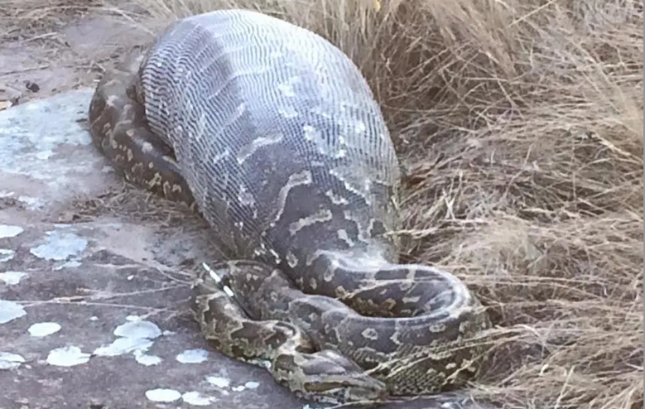

Pseudo Code
The code before the code
Use simple language to outline the task you are trying to accomplish
It can/should be used as in-line code comments
Allows the person after you to understand your code and thought process
Look at these pictures, who is ready for the next task?
vs.
The Snake
The Bird of Prey

Slide 12
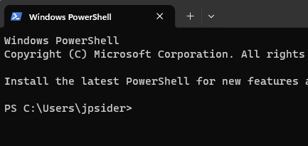

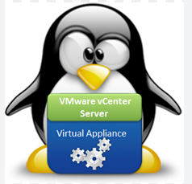


Local PowerShell Modules
Custom, Reusable code to achieve your specific tasks
Let’s jump into it! Here is the Demo environment.

Slide 13
Bonus Topics
Hopefully we have time!
ScriptAnalyzer
Pester
PSReadline

Slide 14
Please take your survey.
Slides & Code
Thank you!
Broadcom Proprietary and Confidential. Copyright © 2024 Broadcom.
All Rights Reserved. The term “Broadcom” refers to Broadcom Inc. and/or its subsidiaries.

